Slide 1
Pew Health Attitudes Analysis
Ryan Mayers

Slide 2
Overview
Using 2014-2016 Pew Global Attitudes Survey
Interested in health care perceptions
Intersection with economic concerns

Slide 3
Limitations of Data Set
Questions are not asked of all countries
Questions and countries not identical year-to-year
Kenya, Nigeria, South Africa used
Limited number of potential subjects to examine
Some questions (one selected) change wording
Low numbers prevent rigorous statistics
Looking for preliminary trends
R-value correlations, but confidence values inappropriate

Slide 4
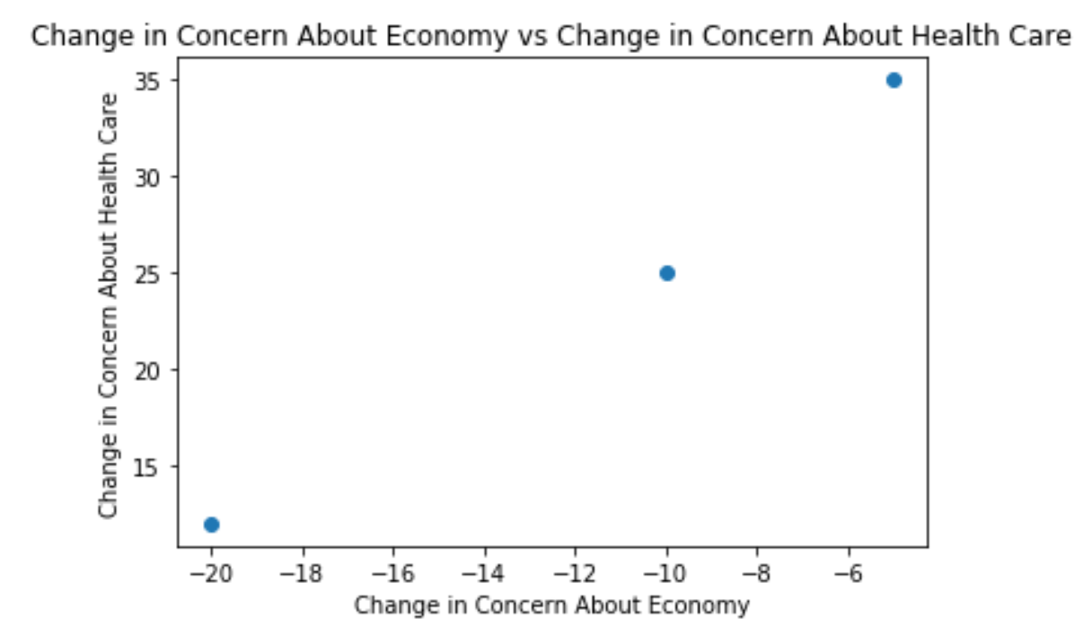
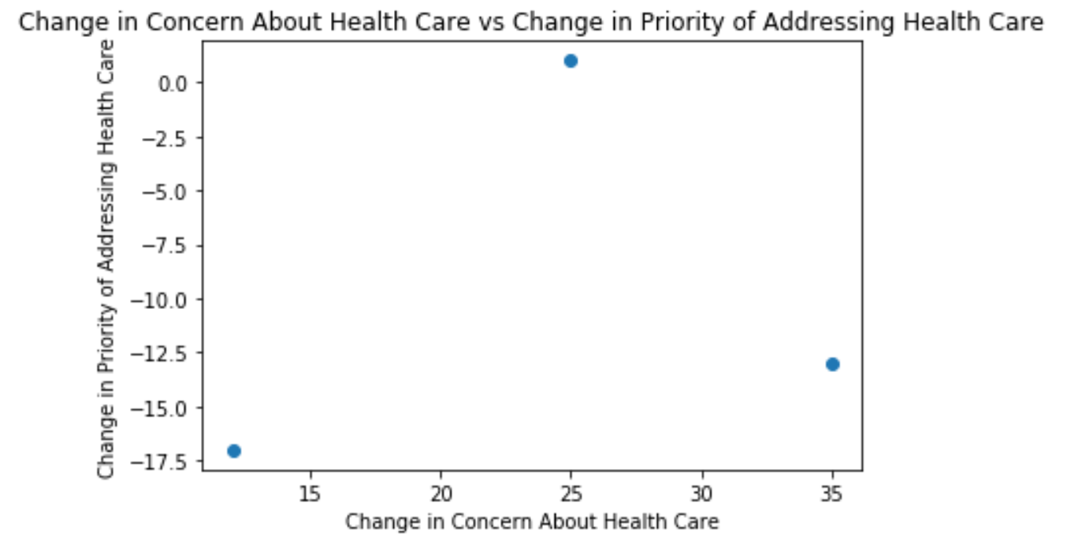
Limitations (cont.)
Data ultimately too limited for analysis project
Switched to proof-of-concept for interactive user interface/analysis

Slide 5
Analysis
3 questions
Health care as a major national problem
View of current economic situation
Optimism about economy
Also measuring change between surveys
All questions measured as % of population

Slide 6
Approach - Overview
Planned out in outlines first
Using Pandas (for DataFrames), MatPlotLib (for plots)
Will use NumPy for R values
Data entered manually
Datasets too large/too many irrelevant questions/countries for import
More familiarity, control over DataFrames & labels/variables/etc
Use of conditionals and while loops with user interface
Manually generates all possible combinations from behind the scenes
Prepares for and prevents any non-requested input/potential crash options
Final Product: Charts, R-Values, User control

Slide 7
Final Product
Generate failproof user-requested charts & R-values
Any user intersection of countries, health care metrics, and economic metrics
Change can only be matched to change
Economic/Health metrics and charts ready
Regression, country-specific sorting WIP
Will not crash/fail with any conceivable user input

Slide 8
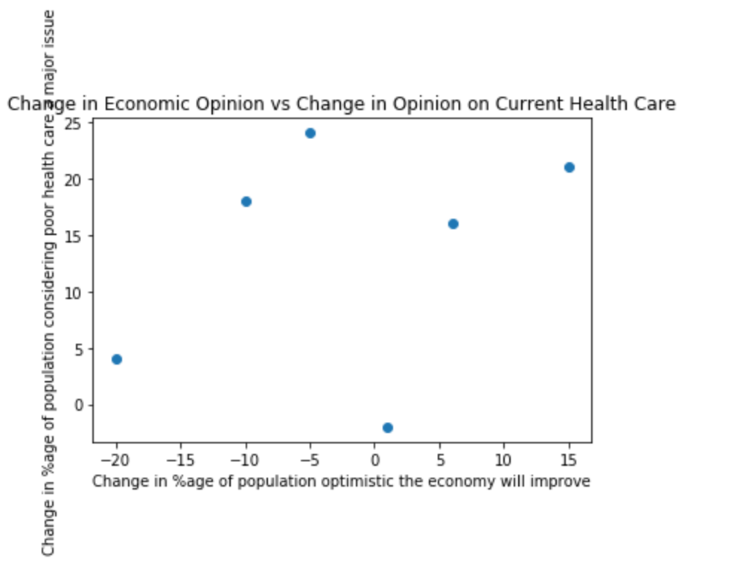
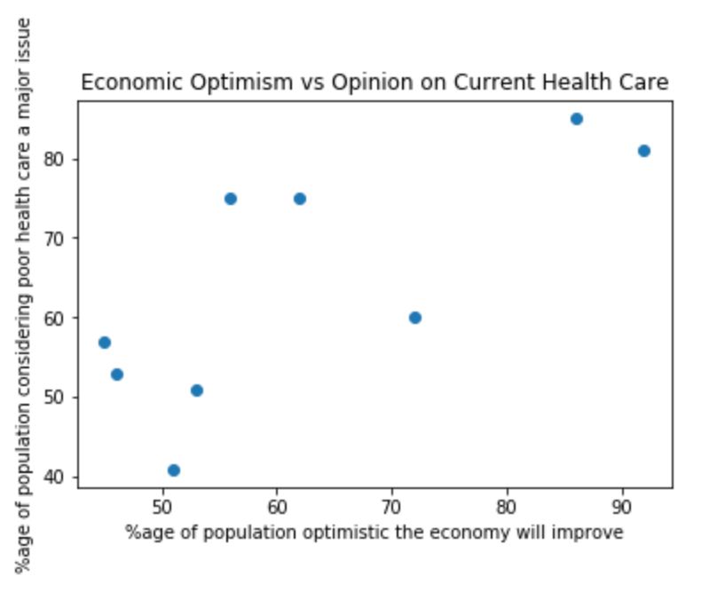
Final Product (cont.)
Functional, but mostly visual
Needs fixes for text length, visuals

